Slide 1
Stretching Your Non Profit Dollars With PR

Slide 2
What’s the Goal of PR?
Fostering mutually beneficial relationships between an organization and its publics

Slide 3
RACE
Research
Action and Audience
Communication
Evaluation

Slide 4
Research

Slide 5
Know Your CRAP
Company and Competition
Resources
Audience and Environmental Analysis
Product and Promotions

Slide 6
Action and Audience

Slide 7
Goals
Statement of being for the plan: completion of goal signifies end of the plan

Slide 8
Objectives
1. Specific
2. Measureable
3. Attainable
4. Realistic
5. Tangible

Slide 9
Audience
If you don’t segment you’re wasting your time and your audience’s time with:
…the wrong message
…the wrong timing
…the wrong media

Slide 10
Audience
WHO: Demographics / Psychographics
WHAT: Self-Interests
HOW: Connectors / Influentials
WHY: Current Relationship
WHEN: All of the Above

Slide 11
Communication

Slide 12
The Message
Your Audience Will Ask:
Is the story appealing?
What’s in it for me?
Is it compatible with my values, needs, beliefs?
Is it easy to remember and do?
Is it easy to try with little or no risk?
Can I observe the consequence of my actions?
Is my action positively reinforced by subsequent messages?

Slide 13
The Message
The Media Will Ask:
Timeliness
Impact
Prominence
Conflict
Uniqueness
Proximity

Slide 14
Can You Hear Me Now?
Will they UNDERSTAND the message?

Slide 15
Can You Hear Me Now?
What’s the
NEXT STEP?

Slide 16
PRO Tip 1
HUMANIZE Everything

Slide 17
PRO Tip 2
Look for the SHADOW STORIES

Slide 18
PRO Tip 3
Create
EVENTS

Slide 19
PRO Tip 4
Build
RELATIONSHIPS

Slide 20
PRO Tip 5
Think About
PESOs

Slide 21
Tactics
Paid | Earned | Shared | Owned
Online | Press release | Social media | Your website
Direct Mail | Media kits | Coalitions | Your signage
Sponsorships | Pitching | WOMA | Your social
Static stickers | Press conferences | Speakers | Talking points
Yard Signs | Media Tours / Events | Partner e-lists | Your newsletter

Slide 22
5 Fast Tips
Pitch Lists, Tips and Infographics (infogram.com)
Check out Google Trends and Google Correlate
Steal Headline Templates on Social
You’ll Never Believe ….
Portent.com – content idea generator
Current customer ambassadors
Fully leverage social media

Slide 23
Bonus: Social Media Tips
Complete your profile including Donate or Sign Up or both
Have a contest or fill in the blank or story sharing
Think in thirds: useful content, us content, other content
Schedule your posts – [I use Hootsuite]
It’s called social for a reason

Slide 24
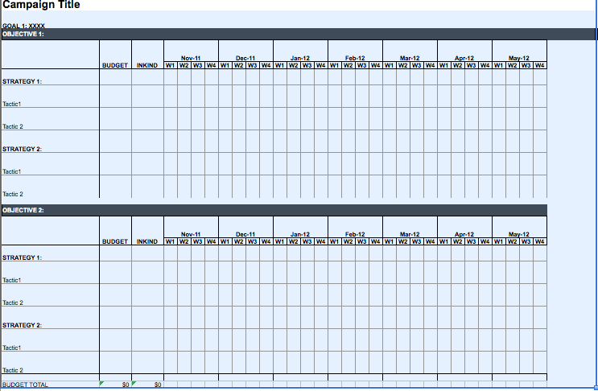

Slide 25
Evaluation

Slide 26
Evaluation
If you were SMART this step is easy
Success that justifies the resource expenditure.
Effectiveness of the program itself
The bottom line:
Your CEO/ED/Client wants results.

Slide 27
Contact
Meghan Waskiewicz
meghan@waskeygroup.com
linkedin.com/in/mdwaskey

