Slide 1

Creating an Effective Board Chair/CEO Relationship
October 24, 2017

Slide 2
Objectives for this session
Overview of nonprofit governance
Inherent issues in nonprofit governance
Understand the importance of the relationship
Identify the roles and responsibilities of the Chair and the CEO
Discuss the elements of teamwork necessary for success
Notes:
Breaks and lunch

Slide 3
Check out www.yournpp.org

Slide 4
Nonprofit Governance sources
BoardSource at www.boardsource.org
  BoardSource “Leading with Intent Index” www.leadingwithintent.org
Gail Perry at www.gailperry.com
Blue Avocado: www.blueavocado.org
National Council of Nonprofits: www.councilofnonprofits.org
Bridgespan: www.bridgespan.org
CompassPoint: www.compasspoint.org/underdeveloped
    National Center for Charitable Statistics: www.nccsweb.urban.org
    Giving USA: www.givingusa.org

Slide 5

A Board of Directors
BoardSource
A nonprofit governing board is expected to represent the public trust by ensuring that the organization carries out the purposes for which it was established and as expressed in its mission statement and that it does so in a responsible and accountable fashion.
Notes:
I particularly like the “What does Board service entail?” handout as a brief description. Glossary is cool as well.

Slide 6
Legal Duties of Board Members
Act in Accordance With Legal Standards
Duty of Care
    Stay informed and ask questions
    Duty of Loyalty
        Show undivided allegiance to organization’s welfare
        Duty of Obedience
        Stay faithful to the organization’s mission

Slide 7
Ten Basic Roles and Responsibilities
BoardSource
1. Determine mission and purpose and advocate for them.
2. Select the chief executive.
3. Support and evaluate the chief executive.
4. Ensure effective planning.
5. Monitor and strengthen programs and services.
6. Ensure adequate financial resources.
7. Protect assets and provide proper financial oversight.
8. Build a competent Board.
9. Ensure legal and ethical integrity.
10. Enhance the organization's public standing.

Slide 8
Challenges to Effective Governance
  Boards are dependent on management for all of the information.
  Members are often unfamiliar with nonprofit management and governance.
  Members are volunteers with limited time.
  CEO is too assertive or not wanting Board input.
  Risk aversion.
  Unrelated personal experiences from the for-profit sector.
  Little consequence to decision-making process. Lack of accountability or perspective.
  Members avoiding tension and conflict.
  Influential stakeholders improperly influencing members or staff (founders, retired Board, etc.)
  Board has difficulty working as a team.
  Board doesn’t truly understand the work of the organization.
  Board doesn’t focus strategically.
  Special issues with member-based organizations.
Notes:
Ask for challenges that the audience has faced.

Slide 9
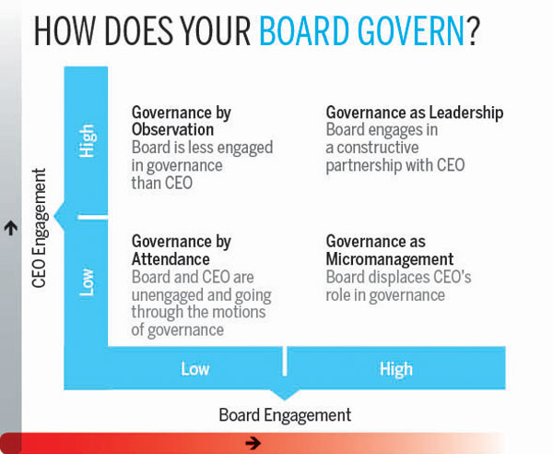
Engaged Board/CEO Relationship

Slide 10
CEO/Board Partnership

Slide 11
Importance of a healthy Board Chair/CEO Relationship
“Exceptional boards govern in constructive partnership with the chief executive, recognizing that the effectiveness of the board and chief executive are interdependent.”—BoardSource

Slide 12
CEO Responsibilities to the Relationship with the Board
        Communicate regularly, openly and honestly.
        No surprises. Transparency is key.
        Staff the Board and committee meetings.
        Assist Board in acting strategically.
        Develop relationships with each member.
        Follow-up on Board action.
        Assists in educating Board.
        Provides Board with all resources necessary to make decisions.
        Understand what the Board needs and wants.
        Help in framing the decision-making process; provide options and/or recommendations.
Notes:
The 6 core competencies is a nice handout. Notice it has nothing on programs.

Slide 13
Ceo expectations from the Board
The Board to act and speak as one.
Directors who are engaged, informed and prepared.
The Board makes timely decisions based on accurate information.
The Board, and individual directors, are accountable.
The Board views the relationship with the CEO as a partnership.
No micromanagement (only governance).

Slide 14
Board Responsibilities to the Relationship
        Support the CEO and commit to appropriate resources.
        Respect CEO’s role as head of the staff.
        Trust the CEO and the information provided.
        Ensure fair and competitive compensation.
        Openly and transparently communicate.
        Manage itself and its interactions with the CEO.
        Assist CEO in developing a succession plan.
        Properly utilize committees.

Slide 15
Board expectations from the CEO
The CEO will provide clear and accurate information (no surprises).
The CEO will assist the Board in identifying strategic issues that need Board attention.
The CEO will effectively manage the staff and develop internal leadership.
The CEO will help manage and support the Board.
The Board’s time and input will be respected

Slide 16
Elements of a positive board chair/ceo relationship
        Mutual respect, trust, and support for each other and the partnership.
        Reciprocal communications.
        Shared purpose and mission-driven.
        *The Board Chair Handbook
Notes:
Has anyone been through the process of hiring a CEO?

Slide 17
The CEO’s responsibility to the chair
Help orient to the role and expected duties.
Provide honest and accurate information.
Regularly, and appropriately, communicate.
Assist in identifying strategic issues to be addressed by the Board.
Help to guide committee work and set meeting agendas.
Help to set and manage boundaries.

Slide 18
The chair’s responsibility to the ceo
        Attending to a healthy Board culture.
        Commit the time and energy needed to serve.
        Ensure the Board is strategically governing, not managing.
        Hold the Board, and individual members, accountable.
        Openly and honestly communicate to CEO the needs of the Board.
        Manage the expectations and communications between the CEO and Board.
        Advocate on behalf of the CEO when appropriate and necessary.
        Monitor committee work and prepare for and facilitate productive Board meetings.
        Manage Board discussion.
Notes:
Has anyone been through the process of hiring a CEO?

Slide 19
board chair/ceo partnership challenges
*Boardsource
Gender
Age
Ethnic, cultural, religious background
Tenure of chief executive
Personality type
Assertiveness or lack thereof
Degree of confidence in oneself and in the other person
Fear of making waves or hurting feelings
Feeling overwhelmed
Feeling uncertain or intimidated

Slide 20
Meetings should focus on Strategic Issues
Susan Decker, BoardSource
High Urgency/Low Importance
Low Urgency/Low Importance
Low Urgency/High Importance
High Urgency/High Importance
Distraction
Crisis
Low Value
Strategic
Notes:
Where do you spend your time? Rank your discussion items using this chart.

Slide 21
Work together to create effective meetings
Susan Decker, BoardSource
        Strategically-focused meetings.
        Focus on the future, not the past.
        Well-prepared meetings.
        Focused agendas.
        Frame questions—don’t make statements.
        Dashboard reporting.
        Provide introverts the opportunity to participate. Control the extroverts.
        Assign a devil’s advocate.
        Committees doing good work.
        Structure time for strategic/meaningful topics.
        Use Executive Session as needed.
        Regularly evaluate meetings.
Notes:
Dashboards
Allow staff and board members to spot changes and trends
Offer more meaning to hard-pressed board members
Increasingly crucial for boards to quickly access indicators given increased scrutiny that governance has received by media, regulatory agencies, and the public
Provides opportunity for partnership between board and staff
Four tips to help structure successful meetings:
Effective meetings carve out time for meaningful discussion
Effective boards include executive sessions as part of regular practices – Executive sessions exclude staff and can be useful in a number of situations
One way to free up time is by using consent agendas
Dashboards are a tool that some organizations are using to prevent information overload
Meetings should not be where reports are read aloud. These should be sent in advance of the meeting. A meeting is one of the least efficient ways to share information.
Meetings should focus on “”What” and “why” questions.
Also, meeting should include board education, such as a mission moment where someone is invited to address the board whose life has been touched by agency to make a short, personal testimonial on its impact. Board members will then leave meetings ready to raise funds, recruit new board members, and just generally spread the good news about the mission. The mission will thus become better known and so will the organization.
Executive Sessions
Rule Number 1 for executive sessions is to hold them only for the determined purpose. Closed meetings are not occasions for a board to run away from its responsibility and hide from difficult issues that need attention.
Establish rules regarding when and how the sessions will be used - appropriate when:
Substantial barriers exist to board member public candidness
Need time and work before making something public
Examples: Investigating possible board member misconduct, planning major endeavors such as a merger, confidential issues

Slide 22
  Questions/Concerns?

