Slide 1
The Heart of Fundraising:
Doing What’s Right!
Presented by: Gary L. Bukowski, MA, CFRE
Associate Vice President of Development
Sarah A. Reed Children’s Center
May 26, 2017
Celebrating 145 Years!

Slide 2
Today’s Agenda:
AFP Code of Ethical Standards
Donor Bill of Rights
Values Promoted by the AFP Code of Ethics
Doing Well by Doing Right: A Fundraiser’s Guide to Ethical Decision-Making
All Well and Good: A Case for the Ethics of Philanthropic Fundraising
Seven Ethical Dilemmas in Philanthropic Fundraising
Bukowski’s Data Points
Can Familiarity Cause Ethical Dilemmas?
Case Studies – Review & Discuss
Helpful References

Slide 3
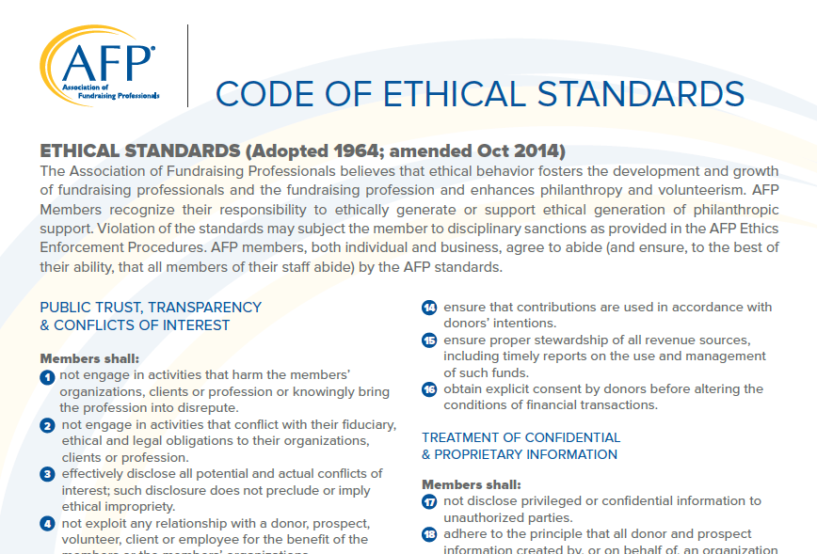
AFP Code of Ethical Standards

Slide 4
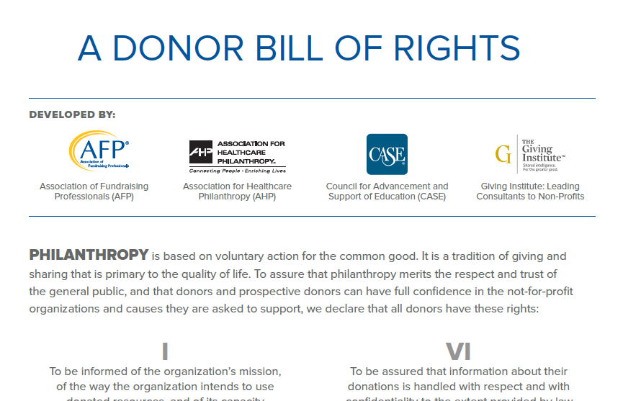
Donor Bill of Rights

Slide 5
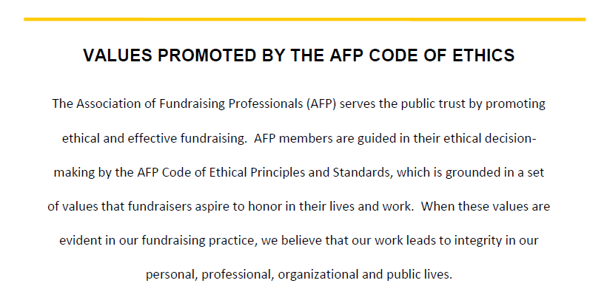
Values Promoted by the AFP Code of Ethics

Slide 6
Doing Well by Doing Right:
A fundraiser’s guide to ethical decision-making
Challenges That Can Cause Ethical Dilemmas:
Extreme goal pressures
Lack of experience
Dilemmas without clear solutions
Superiors who don’t understand fundraising/ethical standards associated with our profession
Don’t be impulsive on your decision-making
Donors who want to control their gift
When the Development Officer knows more than the donor’s advisor
Gifts that eat

Slide 7
Doing Well by Doing Right:
A fundraiser’s guide to ethical decision-making
Common Misconceptions About Ethics:
Believing that “good” people do not need to worry about ethics training
Making sound ethical decisions is simply a matter of common sense
If something is legal, it is ethical *Not true! NP Fundraising vs. Political Fundraising
Ethics does not directly impact my organization
“Others believe that if something is legal, it is ethical. The reality is that society first decides what is ethical or unethical, and then may choose to codify that into law. Therefore, many things remain unethical despite the fact that they might be perfectly legal.”
~Michael Rosen

Slide 8
Doing Well by Doing Right:
A fundraiser’s guide to ethical decision-making
Helpful Suggestions for Testing Your Ethical Decisions (AFP):
The Vision Test: Can you look yourself in the mirror?
The What-Would-Your-Parents-Say Test: Could you look them in the eye?
The Kid-on-Your-Shoulders Test: Would you be comfortable if your kids saw you?
The Publicity Test: Would it be ok if your decision was front-page news tomorrow?

Slide 9
Doing Well by Doing Right:
A fundraiser’s guide to ethical decision-making
“Trust cannot be assumed. It must be earned.” ~Michael Rosen
How Do We Earn Our Donors’ Trust?
Convince/show donors that their donation will get through to & have an impact on those you serve.
Communicate more effectively
Solicit with less pressure
Maintain the highest ethical standards & communicate this commitment to your donors and prospective donors!

Slide 10
Doing Well by Doing Right:
A fundraiser’s guide to ethical decision-making
Research Shows:
1. “Trust impacts propensity for giving and the amount given.”¹
“Where donors believe that the management of a particular organization exercises good judgement, higher levels of trust may result.” ¹
“The public is demanding a greater demonstration of ethical behavior by all of our institutions and leaders…To the extent the public has doubts about us, we shall be less able to fulfill our public service.” ²
¹ Study conducted by researchers at the Henley Management College in the U.K. (Sargeant and Lee, 2002)
² Report issued by the Independent Sector (2002)

Slide 11
Doing Well by Doing Right:
A fundraiser’s guide to ethical decision-making
“Organizations that routinely utilize ethical decision-making practices will be much better prepared to handle a crisis when it hits.” (Independent Sector, 2002)
Decision-Making Models:
Fischer Model (the recommended model for fundraising ethics)
Josephson Institute Model *Stop & Think *Clarify Goals *Determine the Facts *Develop Options *Consider the Options *Choose *Monitor & Modify

Slide 12
Doing Well by Doing Right:
A fundraiser’s guide to ethical decision-making
Fischer Model:
PERSPECTIVES | ALTERNATIVES
ORGANIZATIONAL MISSION: Does this alternative promote or detract from the organization’s mission or fundamental purpose? Basic philanthropic values? How does this alternative affect those ultimately receiving the services? | 1 | 2 | 3
RELATIONSHIPS: Does this alternative strengthen long-term relationships with colleagues, donors, volunteers and the community?
PERSONAL INTEGRITY: In what ways does this alternative help or not help you develop into the person you want to become? How does it strengthen or weaken your Personal Integrity?
---------------------------------------------------------------------------------------

Slide 13
All Well and Good:
A Case for the Ethics of Philanthropic Fundraising
The Premise:
Society’s most deeply held values are expressed in the work of nonprofit organizations
Those charged with raising this support – both professional fundraisers and other paid and volunteer organizational leaders – have dual obligations: 1. Effective fundraising to support mission-based organizations 2. Ethical practices consistent with mission-based values and the demands of serving the public trust

Slide 14
All Well and Good:
A Case for the Ethics of Philanthropic Fundraising
Paul C. Pribbenow, Ph.D., CFRE, AFP Ethics Committee, June 2014
The Logic
The AFP mission statement aspires to promote fundraising practice that is both ethical and effective in service to the public trust and a healthy democracy
Philanthropic fundraisers (and other nonprofit leaders) serve the public good – they are, in that way, public servants. The work they do serves causes that reflect society’s most deeply held values: education, health, justice, environmental well-being, vital arts and culture, etc.

Slide 15
Seven Ethical “Dilemmas” in Philanthropic Fundraising
Tim J. Burchill, CFRE (deceased) Former Executive Director at The Hendrickson Institute for Ethical Leadership at Saint Mary’s University of Minnesota
Dilemma #1: Tainted Money
Dilemma #2: Compensation
Dilemma #3: Privacy
Dilemma #4: Stewardship
Dilemma #5: Honesty and Full Disclosure
Dilemma #6: Conflicts of Interest
Dilemma #7: The Appearance of Impropriety

Slide 16
Bukowski’s Vital Data Points “Bukowski-isms”
Importance of the truth
Accountability to donors *Anonymous donors
Respect donor intent
Establish gift acceptance and gift counting policies for annual, major and planned gifts in advance of your campaigns.
Transparency of fundraising costs *990s – Annual Report – VSE Report (colleges/high schools ) – Finance/Development
*Kent Stroman - Event Analysis: Gross, Expenses, Profit. What REALLY goes toward your cause after your special event?

Slide 17
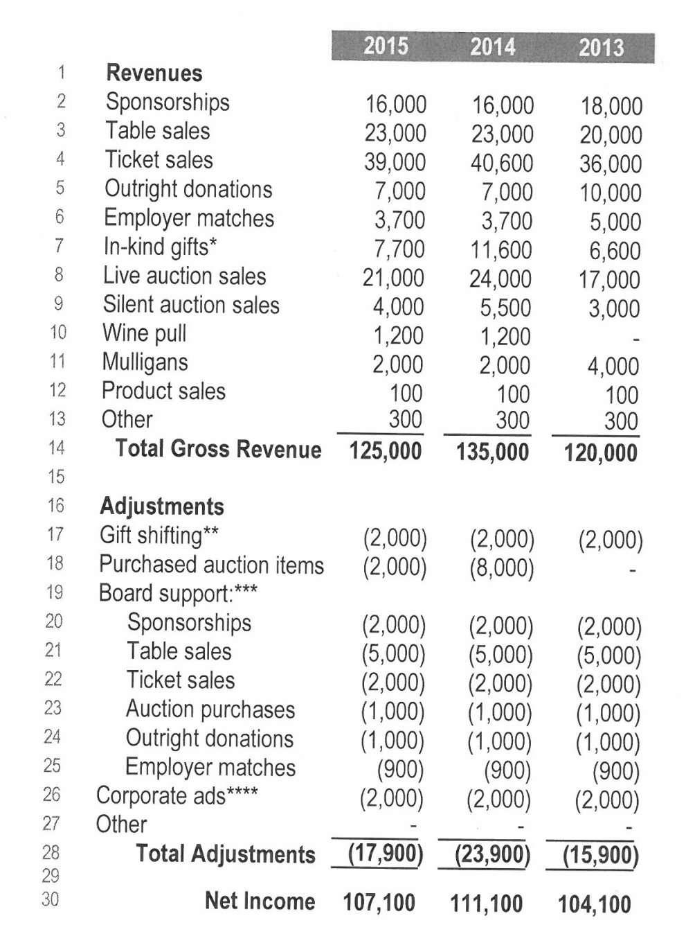
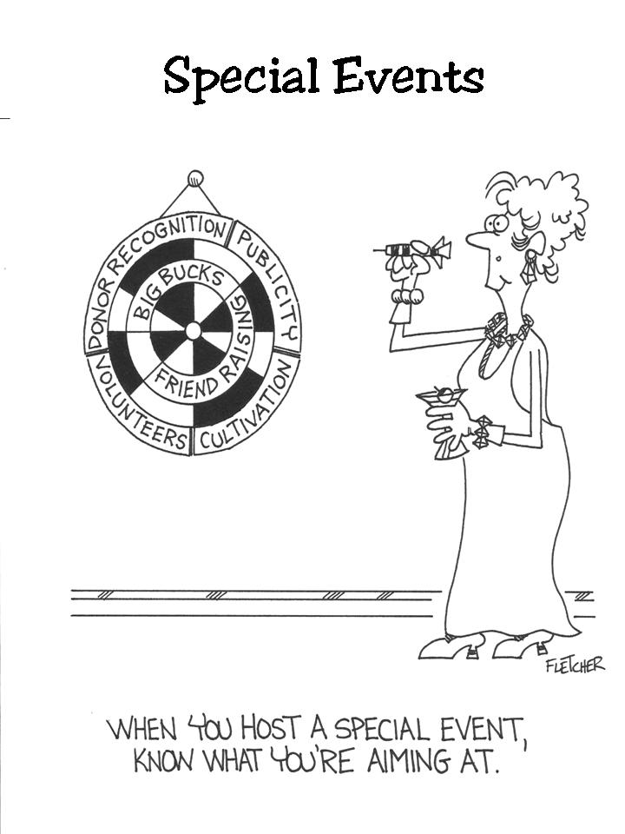
Bukowski’s Vital Data Points “Bukowski-isms”
Transparency of fundraising costs *Example

Slide 18
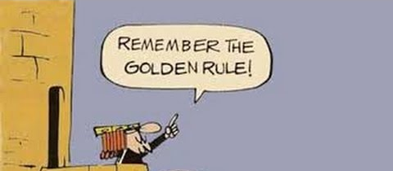
Bukowski’s Vital Data Points “Bukowski-isms”
Treat others how you would want to be treated
“A code of ethics is a guide and while it sets parameters for behavior, there will almost always be gray areas. Ethics is about every day choices, some are clear and some are not. For this reason, no code can address all ethical dilemmas. The code can provide guidance, but it is not definitive.”
~Paulette V. Maehara, CFRE, CAE (2003) Former President and CEO of AFP

Slide 19
Can Familiarity Cause Ethical Dilemmas?
Ann (a major gifts officer for a private teaching hospital) secures a $50,000 gift for a proposed cardiology wing from one of the hospital’s top cardiologists…who also happens to be her domestic partner/spouse. ETHICAL CHALLENGES?
Donor Relations
Conflicting Values
Does a Close Relationship Become an Issue?

Slide 20
Case Studies for Review & Discussion
Case Study #1: “Just be Collegial”
Case Study #2: “You’re So Great, You’re in the Estate!”
Case Study #3: “To Print or Not to Print?”
Case Study #4: “The Big Favor”

Slide 21
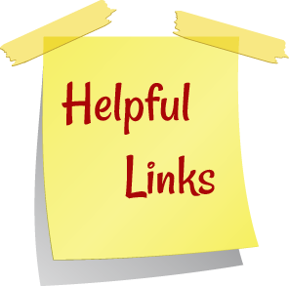
Recommended References
Association of Fundraising Professionals
(Cases for Ethics Education)
www.AFPNet.org
Stress-Testing Our Fundraising Ethics
https://www.blackbaud.com/files/resources/recordings/Blackbaud_HEForum_JohnLippincott.pdf
Ethical Fundraising Article
Ethics & Accountability for Nonprofits Article
https://www.councilofnonprofits.org/tools-resources/ethical-fundraising https://www.councilofnonprofits.org/tools-resources/ethics-and-accountability-nonprofits
How Ethical is Your Nonprofit?
https://www.guidestar.org/Articles.aspx?path=/rxa/news/articles/2004/how-ethical-is-your-nonprofit-organization.aspx
“Doing Well by Doing Right: A Fundraiser’s Guide to Ethical Decision-Making” by Michael Rosen
http://mlinnovations.com/yahoo_site_admin/assets/docs/Ethical_Decision_Making_Article.28164930.pdf

Slide 22
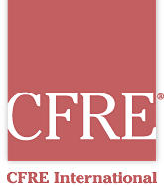
Recommended References
Rogare: The Rights Stuff – Fundraising’s Ethics Gap and a New Theory of Fundraising Ethics
https://www.plymouth.ac.uk/uploads/production/document/path/7/7583/WR_RFJ22668_6046_Ply_RogareReviewFundraisingEthics_A6_210916_V7.pdf
The Fundraising Ethics Gap
http://www.theagitator.net/research/the-fundraising-ethics-gap/
Avoid Fundraising Compliance Penalties and Raise More Money
https://bloomerang.co/blog/avoid-fundraising-compliance-penalties-and-raise-more-money/
Accountability Standards
http://www.cfre.org/accountability-standards/

Slide 23
Recommended References
Nonprofit Fundraising Rules for Pennsylvania
http://www.nolo.com/legal-encyclopedia/nonprofit-fundraising-registration-rules-pennsylvania.html
PA Department of State Business & Charities
http://www.dos.pa.gov/businesscharities/pages/default.aspx
President’s Perspective: Ethics and Economics
http://www.case.org/Publications_and_Products/2012/January_2012/Presidents_Perspective_Ethics_and_Economics.html
Kent Stroman’s Webinar: “Bridging the Gap Between Fundraising Events and Major Gifts”
https://bloomerang.co/blog/video-bridging-the-gap-between-fundraising-events-major-gifts/
“Reconciling Advancement Services and Accounting” by Jan Shimshock
http://fundsvcs.org/modules/wfdownloads/visit.php?cid=19&lid=649

Slide 24
Gary L. Bukowski, MA, CFRE Associate VP of Development
Sarah A. Reed Children’s Center
GBukowski@SarahReed.org
(814) 835-7602

