Slide 1
Get Organized

Slide 2
The Three Ms Your Guiding Principles
Mindful Mindset
Manage Time
Master Habits

Slide 3
MINDFUL MINDSET

Slide 4
When you attend to all things, everything gets shortchanged and nothing gets its
due focus

Slide 5
PRIORITY
ONE

Slide 6
The Thieves of Productivity
1. Can’t Say “NO”
When you say ‘yes’ – understand what you’re saying ‘no’ to
2. Fear of Meltdown
Block it later if it has to be done.
3. Shiny Object Syndrome
Recovery time up to 26 minutes

Slide 7
The Thieves of Productivity
4. Poor Health Habits
Pray /Meditate
Eat right, exercise and sleep
Hug, kiss and laugh
Set goals, plan and calendar
Time block your PRIORITY 1 every day

Slide 8
Next Steps: Mindfulness
What is my PRIORITY—
the ONE THING that will make everything else
easier or unnecessary?

Slide 9
MANAGE TIME

Slide 10
Day, n. A period of 24 hours, mostly misspent
-Ambrose Bierce

Slide 11
Time Blocking Principles
Tell every minute where it belongs
Chunk time together
Make Two Groups: CREATE & CONNECT
Remember your priorities
Stop multitasking – it kills brain cells (MIT)

Slide 12
5 Time Blocking Tips
Reduce meeting times to 30 minutes
“Eat the Frog”
Chunk your time
Buffer zones & planning time
If you erase, you have to replace

Slide 13
Next Steps: Time Blocking
What’s your PRIORITY for time blocking?

Slide 14
MASTER HABITS

Slide 15
“People do not decide their futures, they decide their habits and their habits decide their futures.”
-FM Alexander

Slide 16
66 Days

Slide 17
Email
Inbox ZERO
ONE touch
Under TWO minutes

Slide 18
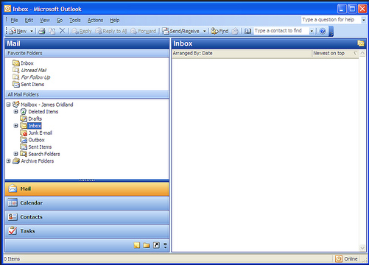

Slide 19
Tasks
Recurring Tasks
Everything you need to do
Use dates
Make space to do them as they come in

Slide 20
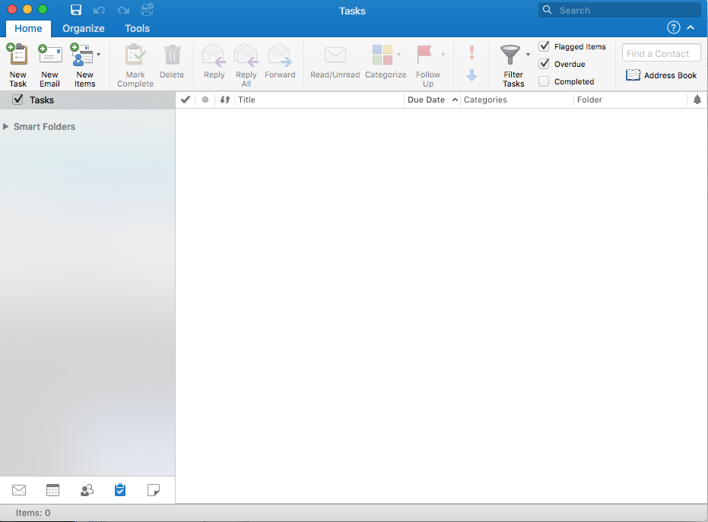
2
1

Slide 21
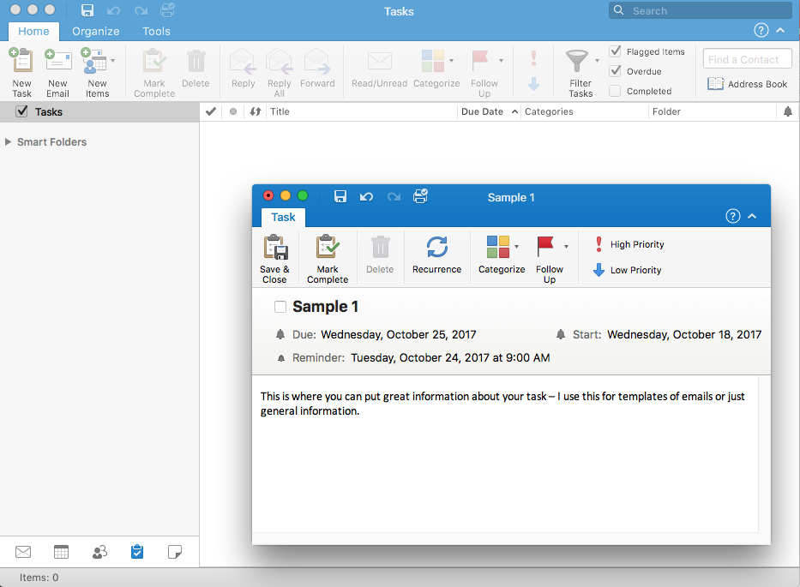

Slide 22
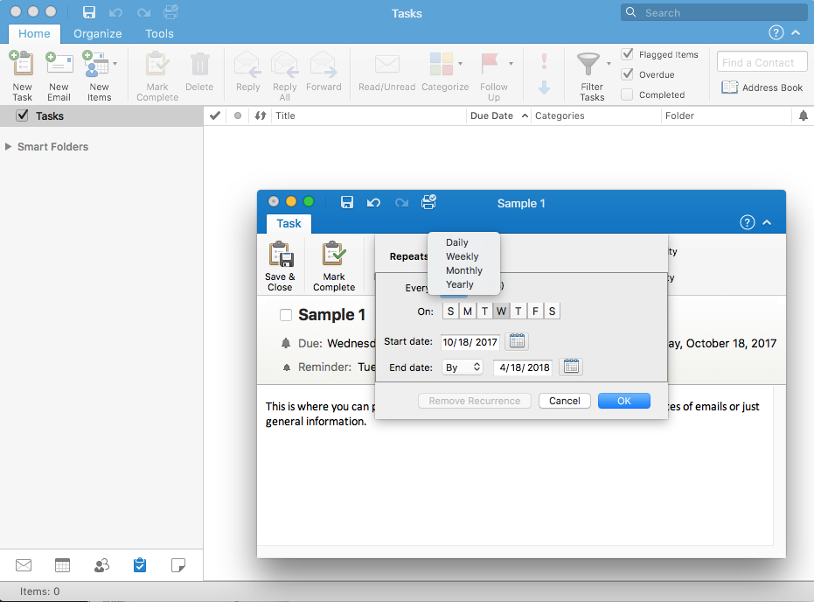

Slide 23
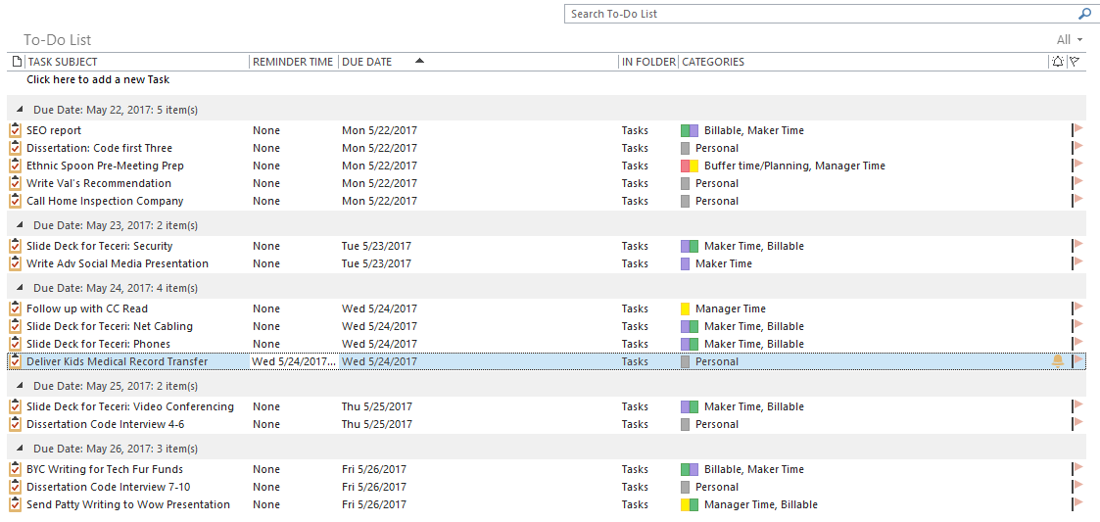

Slide 24
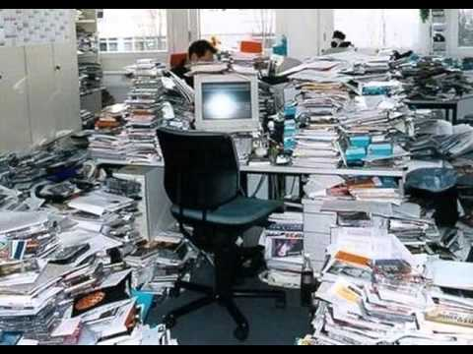

Slide 25
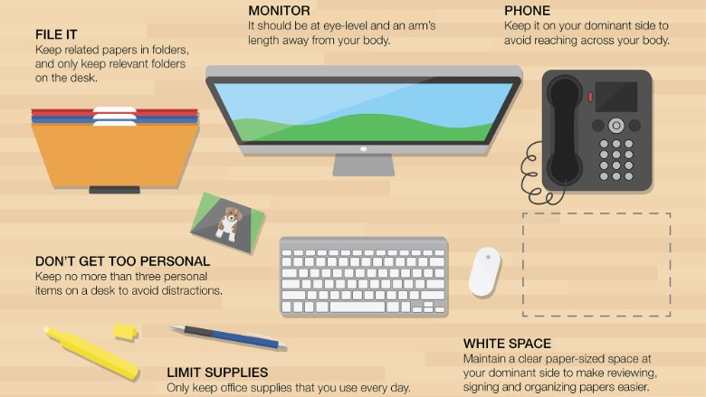
CNN Money, 2015

Slide 26
NEXT STEPS: Master the Habits
Block 4 hours to jump start
Be mindful about email and tasks
Move email >12 months to ‘Old Email’ folder
Purge Your Office
Establish work zones
Revise your filing system (online and offline)
Be OK with the cha-cha

Slide 27
Wrap Up

Slide 28
The Power of Focus
Actions build on actions
Habits build on habits
Success builds on success

Slide 29
BIG NEXT STEP
What’s the PRIORITY
for the next
66 days?

