Slide 1
Posting on social media is not a strategy
Developing your integrated communications plan

Slide 2
A bulldog named Lefty
Notes:
Intro: 5 minutes
Like many of you, one day I was trolling my Facebook feed in my spare time. (Ha.) So, I really had other things to do, but I was trolling my Facebook feed anyhow.
So as I was trolling, like many people do, I stop on photos and videos of humorous dog antics. One of my FB friends is a huge lover of bulldogs. Their third bulldog, Lefty has been quite an entertaining addition to the family.
I happened upon this video of Lefty, who like my dog, doesn’t seem to understand that he is a dog.
https://www.facebook.com/jonrstahl/videos/10154798417541714/
As you can see, Lefty likes to zip line. And in fact, he does this often. He taught himself by watching the kids play on the zip line.
So why is the story of zip-lining Lefty so important? Well, in the world of communication, it really isn’t.
Was it funny or entertaining? Sure. How often do you see dogs that zipline?
Did I share it on my feed? Sure. So did many others.
But beyond that, was it really relevant?
Did it create a call to action?
Does it send a compelling message?
Is it going to make me do anything different because of it? Well, maybe I will continue to watch fun dog videos to pass the time, but really, I can’t think of any significant behavior I will change because of it.
That’s the challenge with social media. Much of it is posted and viewed without any type of strategy behind it.
We could look at cool videos of Lefty and other dogs all day. But we really wouldn’t get anything done. Also, that’s not why we are here, right? We’re here to learn more about how to effectively communicate with our donors. As nonprofits with often limited budgets and resources, every minute and dollar counts when it comes to communicating with others.

Slide 3
Engagement – meet strategy
Tell stories
Match method to audience
Be consistent and clear
Set goals
Develop action plans
Notes:
It provides our clients with an alternate way to find you/searchable
Legitimizes your business/ Gives you a professional presence
Provides a platform that allows your organization to tell its story.
Reinforces branding

Slide 4
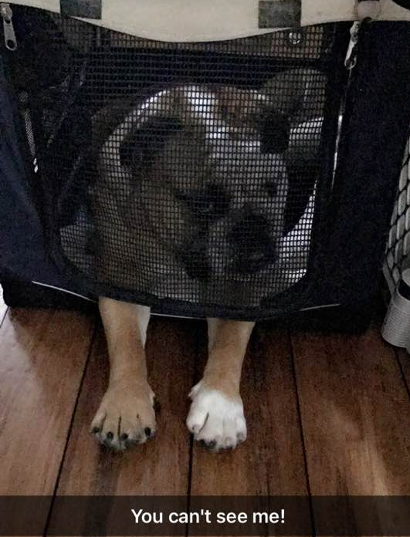
Tell a story
Notes:
What kind of camera are you using?
Smartphone or tablet?
Megapixels matter!
A lack of resolution is the most common problem we see. Pixels are small squares that are put together like pieces of a puzzle to create your photographs. A megapixel is 1 million pixels. That means that the more megapixels you have, the more you can “blow up” the photo before it starts to distort. Make sure your camera is set to the highest resolution. This is probably located in your camera settings.
ZOOM – don’t use it. It will only cause your resolution to decrease. Consider getting up
Clean the lens! No one wants a blurry photo of a Trustee.
Turn on the grid (if you have one)
Take a moment to assist anyone with finding this possible setting

Slide 5
Understand your audience

Slide 6
Age isn’t just a number
Different generations = different communications
Greatest generation - 1890-1927
Silent generation - 1928-1945
Boomers - 1946-1964
Gen X -1 965-1980
Millennials - 1981-1997

Slide 7
Keep their attention

Slide 8
Decide your goals
General awareness
Promote new service or program
Build volunteer base
Raise $$$$

Slide 9
Build timeline/action plan
Who
What and where
When
Why

Slide 10
Talking through your plan
Day by day
Week by week
Month by month

Slide 11
Questions?

