Slide 1


Best Place to Work
We have an awesome Team!!
CEO

Slide 2
DISCLAIMER
We are not experts and this is our first attempt to develop a BPTW program
Many ideas I share are not our own and “borrowed” from other successful programs
Based on my experience preparing this presentation, it’s very hard to make a fun presentation on “having fun”!

Slide 3
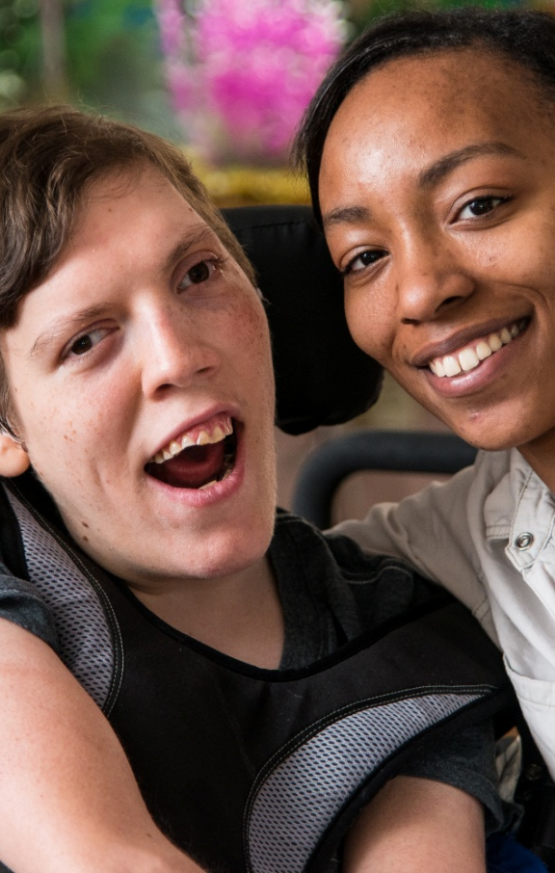
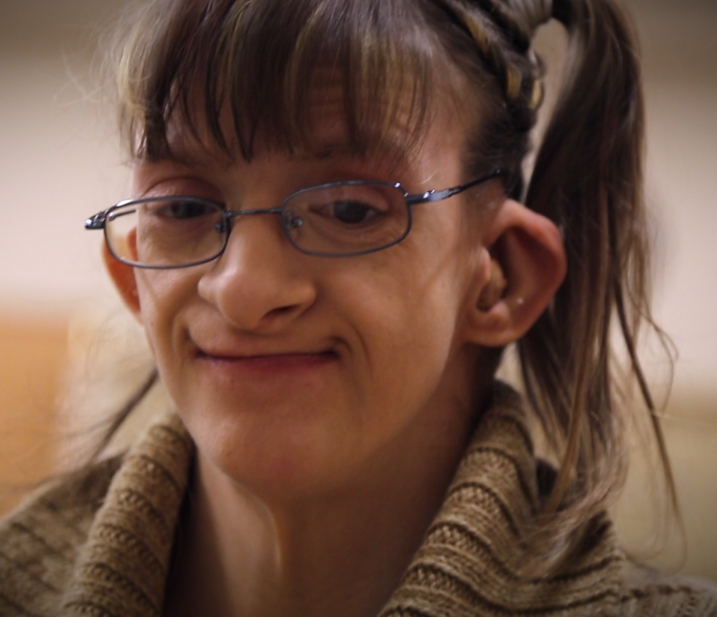
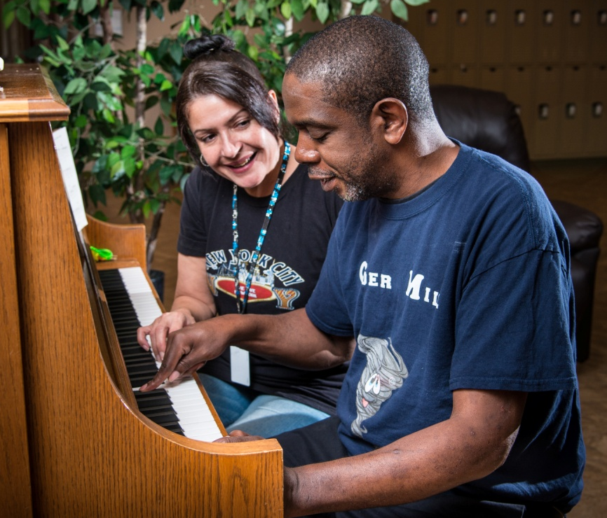
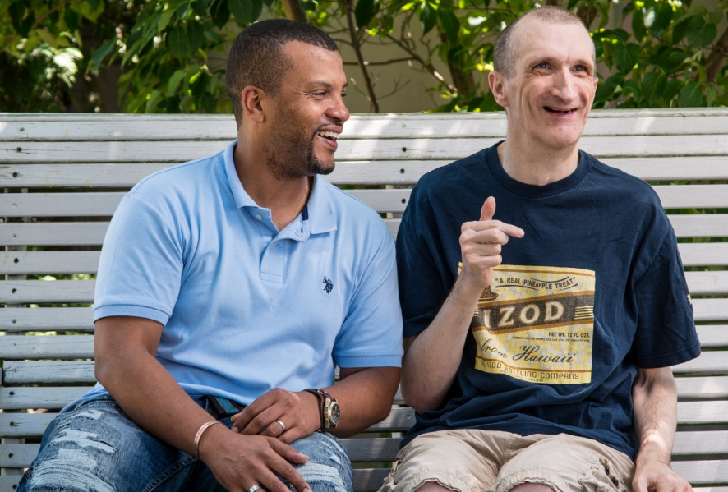
Our mission
The mission of EHCA is to assist people with disabilities to live rich & fulfilling lives.

Slide 4
Residential & Community Programs*
Residential 100 individuals supported $13,850,000 approximate budget
MOVE 50 individuals served $950,000 approximate budget
Options Nearly 220 individuals supported $4,400,000 approximate budget
Life Sharing 25 (+)individuals supported $1,200,000 approximate budget
PFS 84 families & more than 250 individuals supported
$400,000 approximate budget
*NOTE: size of circle indicates relative program budget, not number of participants

Slide 5
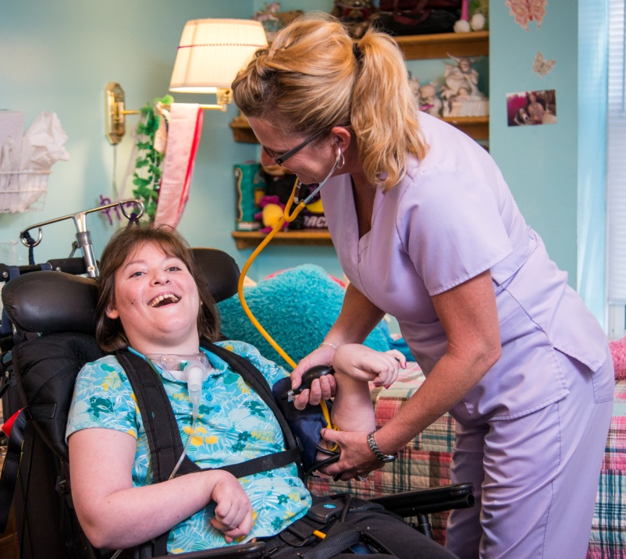
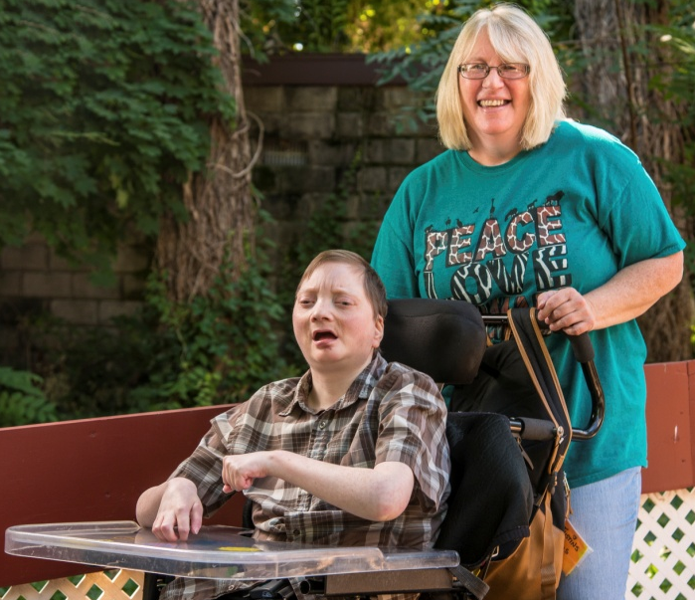
EHCA Facts/Stats Residential
EHCA operates 19 community homes in Erie & Crawford counties, serving 100 full-time residents.
We have over 25 locations
We employ approximately 550 team members
Annual Budget = $22M
Total clients served daily = 400+
We always try to exceed expectations!

Slide 6
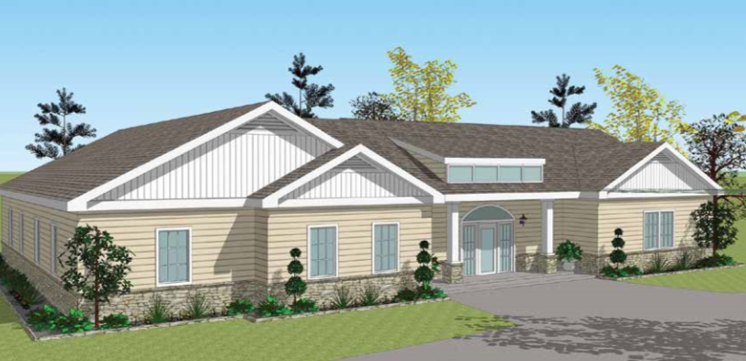
EHCA’s Hope, Compassion, & Possibilities Capital Campaign exceeded all expectations and all of the EHCA family want to extend a huge “thank you” to Erie and the entire community for the generous support!
Campaign Target = $1.5M

Slide 7
The Results!
Approximate face-to-face interactions – 750
Overall “touch points” – in the thousands
Staff pledges - $66,792 – 169 donors (1/3 of our staff participated)
Total board pledges - $390,000 – 100% participation!
Current Campaign total - $2,768,445!!!

Slide 8
Best Place to Work (BPTW)
What it is?
Why do it?
Ideas on how to do it
Other thoughts

Slide 9
What is Best Place to Work? “The EHCA version”
BPTW was initiated in 2016 as an idea to provide greater attention to our employees
On the most basic level BPTW is a framework to create and sustain a work culture where all employees feel engaged, supported and important.
On another level we want our team to be enthusiastic about their role and quite frankly, to enjoy what they do and have fun.

Slide 10
Why we are doing it
It is leadership’s belief we owe it to our team members. Our staff have very important jobs and work hard to make life better for others.
It is a well proven fact that happy employees are more productive, more engaged in their work and have greater retention than those who are not.
It is important to note that we never intended to do for publicity, awards, etc.

Slide 11
Things that are not so important to us
Being awarded certificates, plaques, etc.
Bragging about things other than how much we love working at EHCA
Over use of “Spotlighting” things
Entering BPTW competitions

Slide 12
Important principles of BPTW
It is intended to be dynamic and organic - not prescriptive and we continuously adjust/flex as it will always be a “work in progress”
It is not meant to be onerous in terms of policies, guidelines, etc. – (think KISS Principle)
It is open, accessible and transparent to all
We love adopting ideas from others that have successful BPTW’s
We love sharing our ideas with others

Slide 13
How it is being done
There are three main components to BPTW:
Events and activities
An Employee-centric approach:
Efforts to improve listening to employees
Enhance our ways to recognize employees
Create an educational infrastructure and provide free or very inexpensive opportunities for learning at all levels
Create awareness and branding of our BPTW efforts

Slide 14
Current BPTW Committee Members
Debra Niland - MOVE
Linda Piccirillo – Options
Tammy Weinheimer - Options
Rachael Baginski - Education
Michelle McGuire - MOVE
Penny Bebko - HR
Regina Hoover - Residential
Tina Bednaro - Residential
Brack Smith - Maintenance
Kara Carone – Residential
Marcia Nitczynski - Residential
Karen Tuminello - Marketing
Tamie Tregaskis - Options
Chuck Walczak – Mail Room

Slide 15

EHCA’s BPTW Blueprint
Employees
Clients
BPTW
EVENTS
Families
Volunteers
Have fun
Join in
Be creative
Make Friends
BRANDING AND AWARENESS
EMPLOYEE-CENTRIC
• Communicate
• Understand
• Share
• Listen
• Recognize
• Educate
Our Framework to Create and Sustain a Culture Where
All Employees Feel Engaged, Supported, and Important

Slide 16
Activities and Events
Employee focused
Clients and Employees
Clients, Employees, Board, Volunteers
Clients, Employees, Board, Volunteers and the Community

Slide 17
Activities and Events
Employee focused
April 13-Staff recognition party at the Erie Yacht Club April 26-Happy hour at the Plymouth
May 12-Happy hour at Firebirds
June 24-Happy hour at the Blue Canoe in Titusville
August 17-Golf outing at Harbor Ridge
Aug 18-Corn hole tournament at Camp Sherwin
Week of Sept 10-distribution of lottery tickets to DSP’s
September 15-DSP party at the Elks Club
October 27-Happy hour planned at the Wine Bar
November 4-Wine tour planned

Slide 18
Activities and Events
Clients and Employees May 17-Health fair
May 26-National burger day at the main
June 14-Horse racing at the casino
Oct 21-UPS Halloween party planned at MOVE

Slide 19
Activities and Events
Clients, Employees, Board, Volunteers July 25-Eight Great Tuesdays at Liberty Park
July 6 & 7-LECOM Golf Challenge at Peek’n Peak
Sept 14-Capital Campaign celebration at MOVE

Slide 20
Activities and Events
Clients, Employees, Board, Volunteers and the Community
May 5-The Spring Event at the Bayfront Sheraton
June 12-Partners in Dance at MOVE
June 18-Goretti open house
August 22-Memorial service at MOVE
August 26-Victory Ride

Slide 21
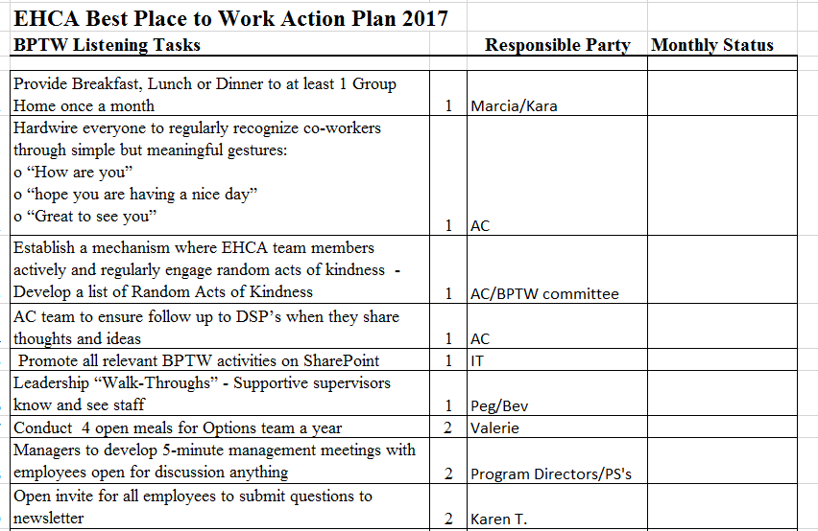
Employee-Centric Plan

Slide 22
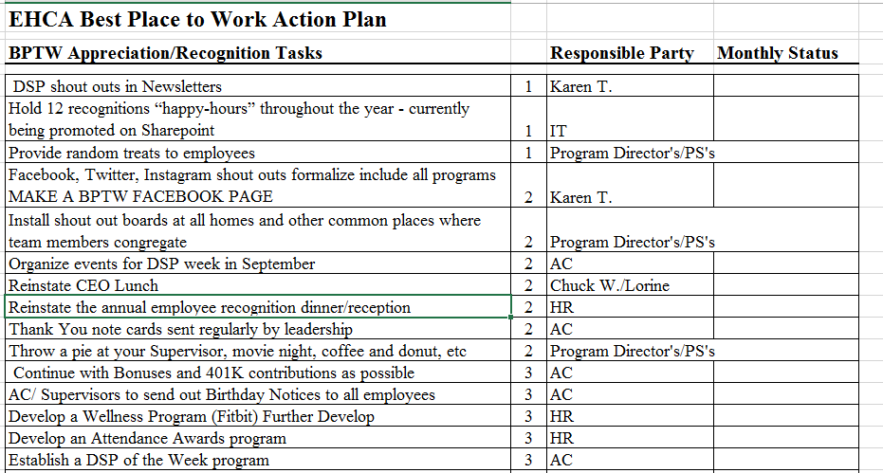
Employee-Centric Plan

Slide 23
Building an Educational Platform

Slide 24



BPTW logos, branding

Slide 25

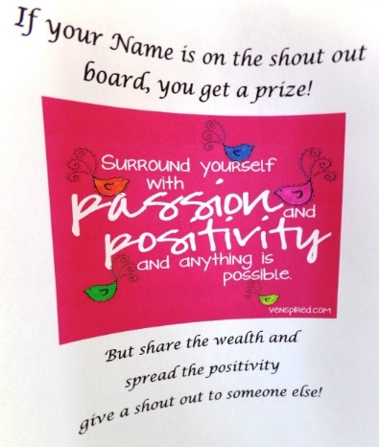
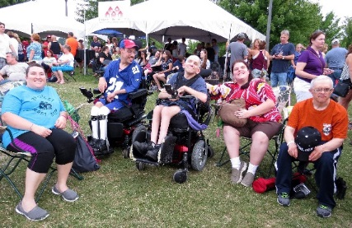
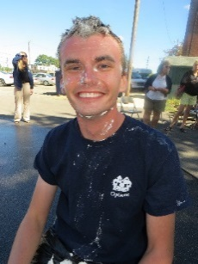

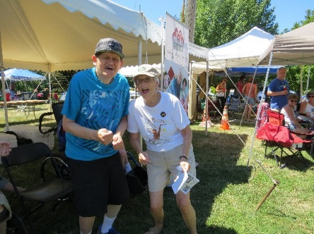
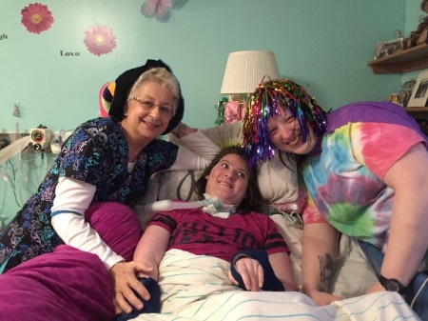
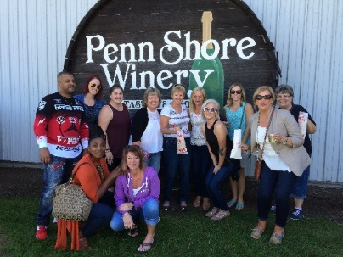
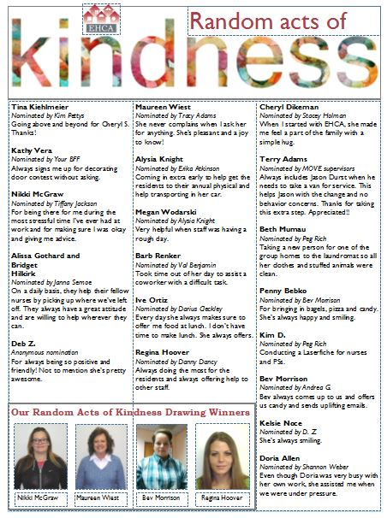



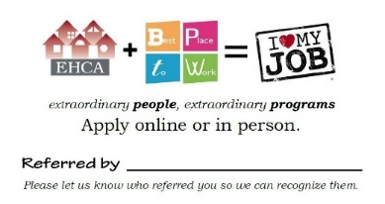
Branding and Awareness

Slide 26
Other Thoughts
Work with others that have successful BPTW’s programs
Wegmans
Erie Insurance
Build BPTW into your new employee orientation
Engage your Board
Create a budget

Slide 27

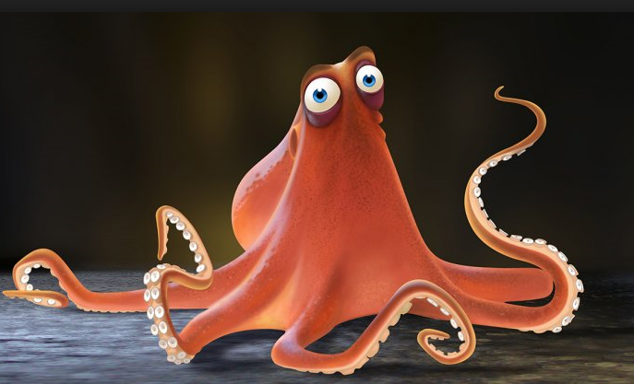
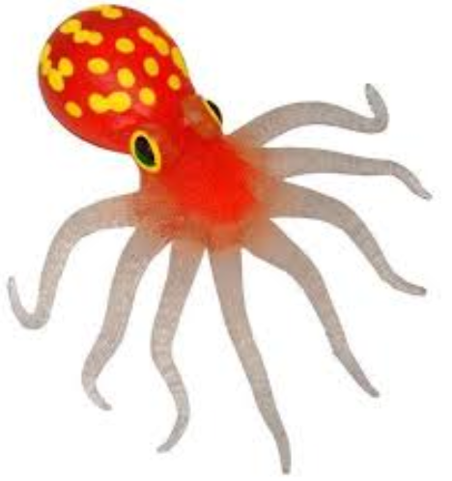



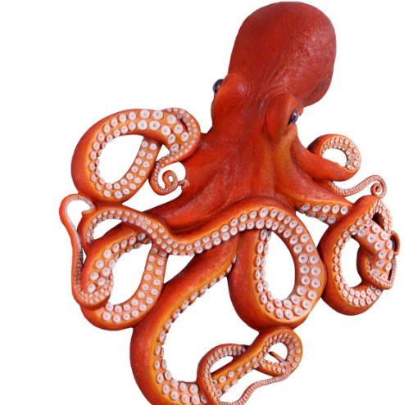
It’s so
much fun!
Thank you for your Interest!
We all love
working at
EHCA!!!
Our clients are awesome!
We have the best CEO ever!!

Slide 28
Questions/Discussion

